Slide 1
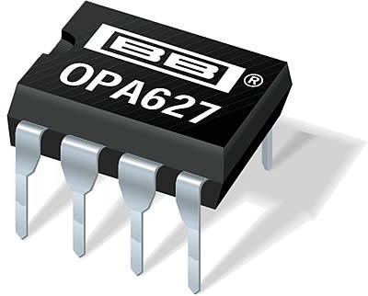

Slide 2
H3
What is the gain?
-0.5
-2
3
-0.333
This circuit won’t work
10k
20k
V_{in}
V_{out}

Slide 3
H3
What is the bandwidth of this circuit if the op-amp f_{T} is 100 MHz?
10 MHz
1 MHz
100 MHz
10 kHz
This circuit won’t work
1M
10k
V_{in}
V_{out}

Slide 4
H3
What is the input impedance of this circuit at low frequencies?
Very small, depends on A of op-amp
Close to 100k
Very large, depends on A of op-amp
Close to 10k
Cannot be determined
100k
10k
V_{in}
V_{out}

Slide 5
H3
What is the output impedance of this circuit at low frequencies?
Very small, depends on A of op-amp
Close to 100k
Very large, depends on A of op-amp
Close to 10k
Cannot be determined
100k
10k
V_{in}
V_{out}

